Slide 1


PROJECT 2
HOTEL RESERVATION ANALYSIS
USING SQL.
- AISHWARYA A SARDESHPANDE
Case study introduction.
Mode of analysis utilized.
Dataset details.
Discussion of Insights generation.
Conclusion.
TABLE OF CONTENTS:

Slide 2
PROJECT 2
HOTEL RESERVATION ANALYSIS
USING SQL.
TABLE OF CONTENTS:
Case study introduction.
Mode of analysis utilized.
Dataset details.
Discussion of Insights generation.
Conclusion.
- AISHWARYA A SARDESHPANDE

Slide 3
PROJECT 2
HOTEL RESERVATION ANALYSIS
USING SQL.
- AISHWARYA A SARDESHPANDE
CASE STUDY INTRODUCTION
In today's data-driven world, the hotel industry stands at the forefront of utilizing data to enhance operational efficiency and deliver exceptional guest experiences. In this project, we will delve into the heart of hospitality by leveraging a hotel reservation dataset.
Through the power of SQL, we aim to extract valuable insights into guest preferences, booking trends, and critical factors influencing hotel operations. We explore how data analytics revolutionizes decision-making and shapes the future of hospitality excellence.
Case study introduction.
Mode of analysis utilized.
Dataset details.
Discussion of Insights generation.
Conclusion.

Slide 4
PROJECT 2
HOTEL RESERVATION ANALYSIS
USING SQL.
- AISHWARYA A SARDESHPANDE
MODE OF ANALYSIS UTILIZED
DATA Collection
In today's data-driven world, the hotel industry stands at the forefront of utilizing data to enhance operational efficiency and deliver exceptional guest experiences. In this project, we will delve into the heart of hospitality by leveraging a hotel reservation dataset.
Through the power of SQL, we aim to extract valuable insights into guest preferences, booking trends, and critical factors influencing hotel operations. We explore how data analytics revolutionizes decision-making and shapes the future of hospitality excellence.
Case study introduction.
Mode of analysis utilized.
Dataset details.
Discussion of Insights generation.
Conclusion.
Data Cleaning and preparation using Excel
Importing Data into SQL for Exploratory Data Analysis (EDA)
Utilizing PowerPoint for Insight presentation.

Slide 5
PROJECT 2
HOTEL RESERVATION ANALYSIS
USING SQL.
- AISHWARYA A SARDESHPANDE
DATASET DETAILS
Booking_ID: A unique identifier for each hotel reservation.
no_of_adults: The number of adults in the reservation.
no_of_children: The number of children in the reservation.
no_of_weekend_nights: The number of nights in the reservation that fall on weekends.
no_of_week_nights: The number of nights in the reservation that fall on weekdays.
type_of_meal_plan: The meal plan chosen by the guests.
room_type_reserved: The type of room reserved by the guests.
lead_time: The number of days between booking and arrival.
arrival_date: The date of arrival.
market_segment_type: The market segment to which the reservation belongs.
avg_price_per_room: The average price per room in the reservation.
booking_status: The status of the booking.
DATA Collection
In today's data-driven world, the hotel industry stands at the forefront of utilizing data to enhance operational efficiency and deliver exceptional guest experiences. In this project, we will delve into the heart of hospitality by leveraging a hotel reservation dataset.
Through the power of SQL, we aim to extract valuable insights into guest preferences, booking trends, and critical factors influencing hotel operations. We explore how data analytics revolutionizes decision-making and shapes the future of hospitality excellence.
Case study introduction.
Mode of analysis utilized.
Dataset details.
Discussion of Insights generation.
Conclusion.
Data Cleaning and preparation using Excel
Importing Data into SQL for Exploratory Data Analysis (EDA)
Utilizing PowerPoint and Power BI for Data Visualization.

Slide 6
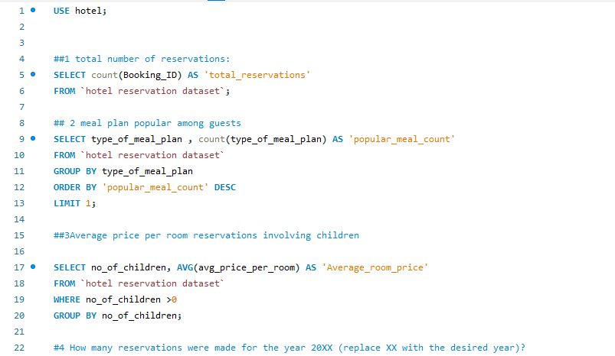
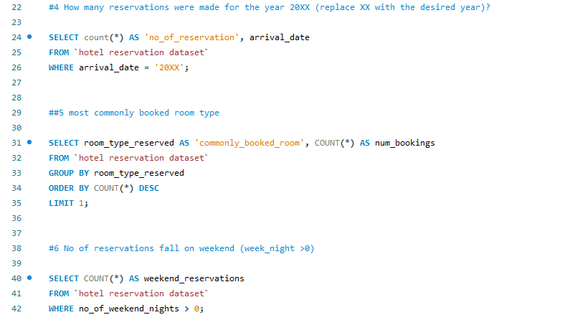
PROJECT 2
HOTEL RESERVATION ANALYSIS
USING SQL.
- AISHWARYA A SARDESHPANDE
Discussion of Insight Generations
DATA Collection
In today's data-driven world, the hotel industry stands at the forefront of utilizing data to enhance operational efficiency and deliver exceptional guest experiences. In this project, we will delve into the heart of hospitality by leveraging a hotel reservation dataset.
Through the power of SQL, we aim to extract valuable insights into guest preferences, booking trends, and critical factors influencing hotel operations. We explore how data analytics revolutionizes decision-making and shapes the future of hospitality excellence.
Case study introduction.
Mode of analysis utilized.
Dataset details.
Discussion of Insights generation.
Conclusion.
Data Cleaning and preparation using Excel
Importing Data into SQL for Exploratory Data Analysis (EDA)
Utilizing PowerPoint and Power BI for Data Visualization.

Slide 7
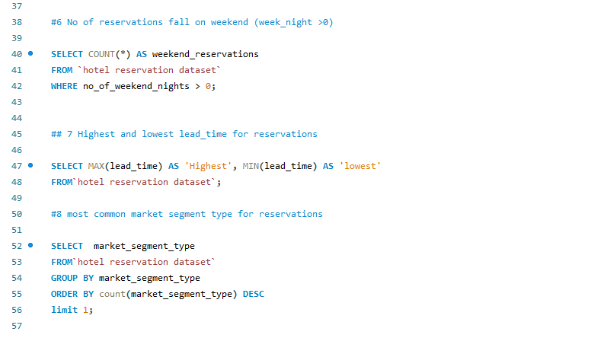
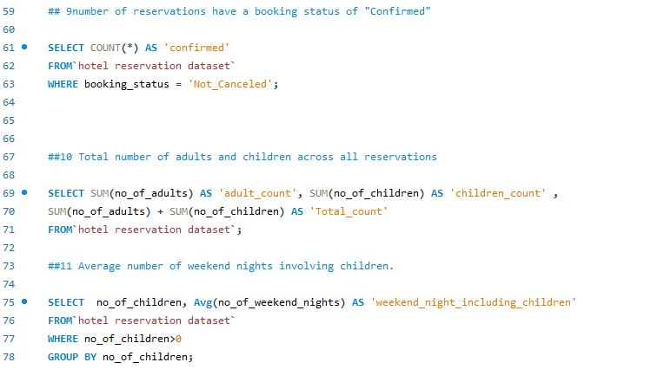
PROJECT 2
HOTEL RESERVATION ANALYSIS
USING SQL.
- AISHWARYA A SARDESHPANDE
Discussion of Insight Generations
DATA Collection
In today's data-driven world, the hotel industry stands at the forefront of utilizing data to enhance operational efficiency and deliver exceptional guest experiences. In this project, we will delve into the heart of hospitality by leveraging a hotel reservation dataset.
Through the power of SQL, we aim to extract valuable insights into guest preferences, booking trends, and critical factors influencing hotel operations. We explore how data analytics revolutionizes decision-making and shapes the future of hospitality excellence.
Case study introduction.
Mode of analysis utilized.
Dataset details.
Discussion of Insights generation.
Conclusion.
Data Cleaning and preparation using Excel
Importing Data into SQL for Exploratory Data Analysis (EDA)
Utilizing PowerPoint and Power BI for Data Visualization.

Slide 8
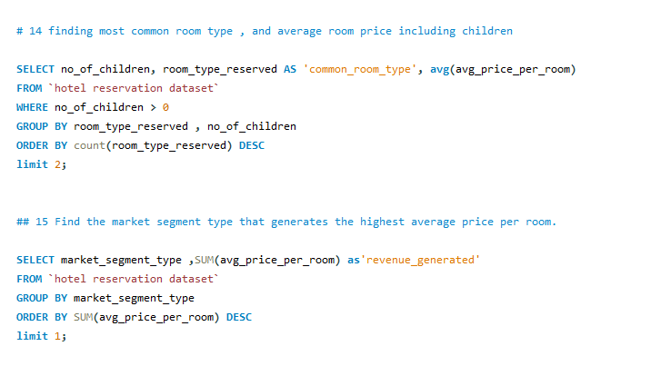
PROJECT 2
HOTEL RESERVATION ANALYSIS
USING SQL.
- AISHWARYA A SARDESHPANDE
Discussion of Insight Generations
DATA Collection
In today's data-driven world, the hotel industry stands at the forefront of utilizing data to enhance operational efficiency and deliver exceptional guest experiences. In this project, we will delve into the heart of hospitality by leveraging a hotel reservation dataset.
Through the power of SQL, we aim to extract valuable insights into guest preferences, booking trends, and critical factors influencing hotel operations. We explore how data analytics revolutionizes decision-making and shapes the future of hospitality excellence.
Case study introduction.
Mode of analysis utilized.
Dataset details.
Discussion of Insights generation.
Conclusion.
Data Cleaning and preparation using Excel
Importing Data into SQL for Exploratory Data Analysis (EDA)
Utilizing PowerPoint and Power BI for Data Visualization.

Slide 9
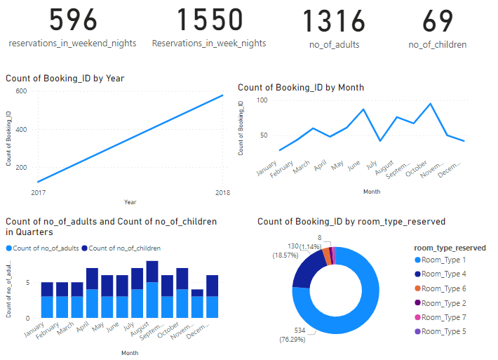
PROJECT 2
HOTEL RESERVATION ANALYSIS
USING SQL.
- AISHWARYA A SARDESHPANDE
Discussion of Insight Generations
Booking_ID: A unique identifier for each hotel reservation.
no_of_adults: The number of adults in the reservation.
no_of_children: The number of children in the reservation.
no_of_weekend_nights: The number of nights in the reservation that fall on weekends.
no_of_week_nights: The number of nights in the reservation that fall on weekdays.
type_of_meal_plan: The meal plan chosen by the guests.
room_type_reserved: The type of room reserved by the guests.
lead_time: The number of days between booking and arrival.
arrival_date: The date of arrival.
market_segment_type: The market segment to which the reservation belongs.
avg_price_per_room: The average price per room in the reservation.
booking_status: The status of the booking.
DATA Collection
In today's data-driven world, the hotel industry stands at the forefront of utilizing data to enhance operational efficiency and deliver exceptional guest experiences. In this project, we will delve into the heart of hospitality by leveraging a hotel reservation dataset.
Through the power of SQL, we aim to extract valuable insights into guest preferences, booking trends, and critical factors influencing hotel operations. We explore how data analytics revolutionizes decision-making and shapes the future of hospitality excellence.
Case study introduction.
Mode of analysis utilized.
Dataset details.
Discussion of Insights generation.
Conclusion.
Data Cleaning and preparation using Excel
Importing Data into SQL for Exploratory Data Analysis (EDA)
Utilizing PowerPoint and Power BI for Data Visualization.

Slide 10
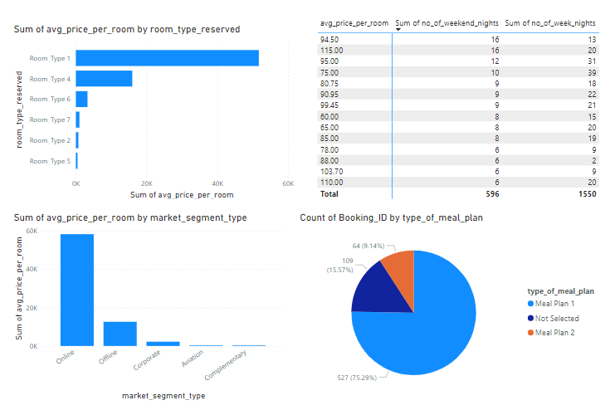
PROJECT 2
HOTEL RESERVATION ANALYSIS
USING SQL.
- AISHWARYA A SARDESHPANDE
Discussion of Insight Generations
Booking_ID: A unique identifier for each hotel reservation.
no_of_adults: The number of adults in the reservation.
no_of_children: The number of children in the reservation.
no_of_weekend_nights: The number of nights in the reservation that fall on weekends.
no_of_week_nights: The number of nights in the reservation that fall on weekdays.
type_of_meal_plan: The meal plan chosen by the guests.
room_type_reserved: The type of room reserved by the guests.
lead_time: The number of days between booking and arrival.
arrival_date: The date of arrival.
market_segment_type: The market segment to which the reservation belongs.
avg_price_per_room: The average price per room in the reservation.
booking_status: The status of the booking.
DATA Collection
In today's data-driven world, the hotel industry stands at the forefront of utilizing data to enhance operational efficiency and deliver exceptional guest experiences. In this project, we will delve into the heart of hospitality by leveraging a hotel reservation dataset.
Through the power of SQL, we aim to extract valuable insights into guest preferences, booking trends, and critical factors influencing hotel operations. We explore how data analytics revolutionizes decision-making and shapes the future of hospitality excellence.
Case study introduction.
Mode of analysis utilized.
Dataset details.
Discussion of Insights generation.
Conclusion.
Data Cleaning and preparation using Excel
Importing Data into SQL for Exploratory Data Analysis (EDA)
Utilizing PowerPoint and Power BI for Data Visualization.

Slide 11
PROJECT 2
HOTEL RESERVATION ANALYSIS
USING SQL.
- AISHWARYA A SARDESHPANDE
CONCLUSION
Targeted Marketing Campaigns:
  Promote weekend stays with special packages and experiences.
Family-Friendly Initiatives:
  Introduce kid-friendly amenities and activities to attract families.
Online Booking Platform Enhancement:
  Invest in improving the hotel's online booking platform for a seamless booking experience.
Room Type Optimization:
  Evaluate features of Room Type 1 and consider replicating in other room types.
Menu Diversification:
  Diversify Meal Type 2 offerings based on guest preferences.
Implementing these solutions ,we can help the hotel capitalize on booking trends, cater to guest preferences, and enhance overall guest satisfaction.
Utilizing PowerPoint and Power BI for Data Visualization.

